Slide 1
AGM report
8 December 2014
Jenny Carr, SRF chairperson

Slide 2
The distinct role of the SRF
Activities
What do members think?
Our reach
Review of 2014
Thanks

Slide 3
The distinct role of the SRF
Educational charity
Tries to promote understanding of all the countries of the FSU
Broad range of interests
“the respective ways of life, history, heritage and the cultural and commercial activities and voluntary services of the said countries and through the creation of educational contacts of all kinds between the peoples of these educational contacts of all kinds between the peoples of these countries” Constitution 3.2
Independent
Voluntary

Slide 4
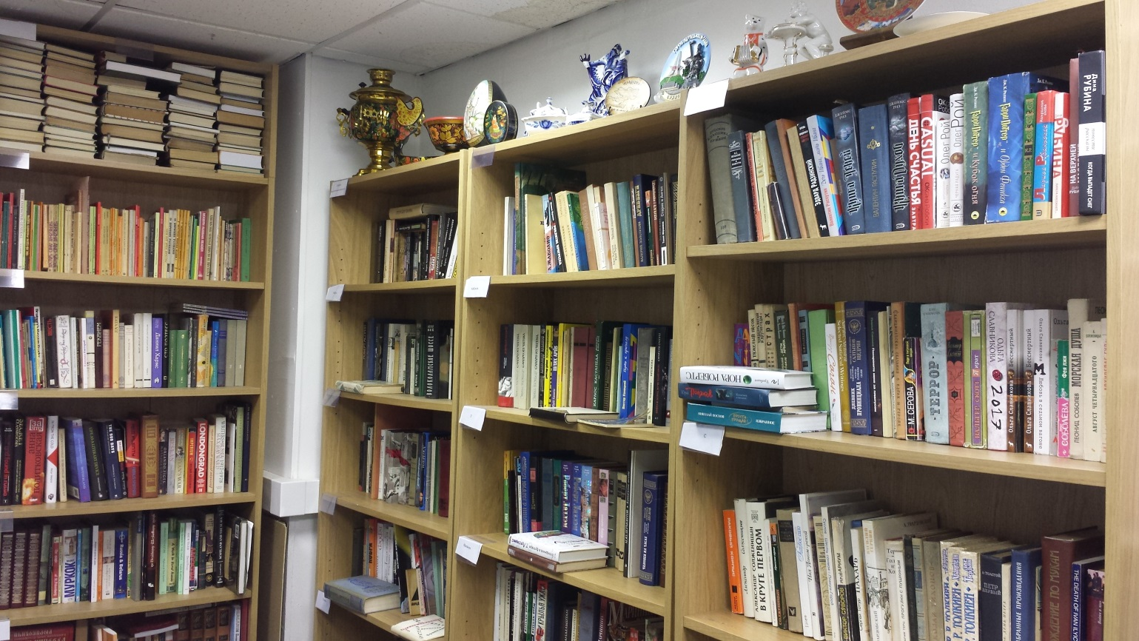
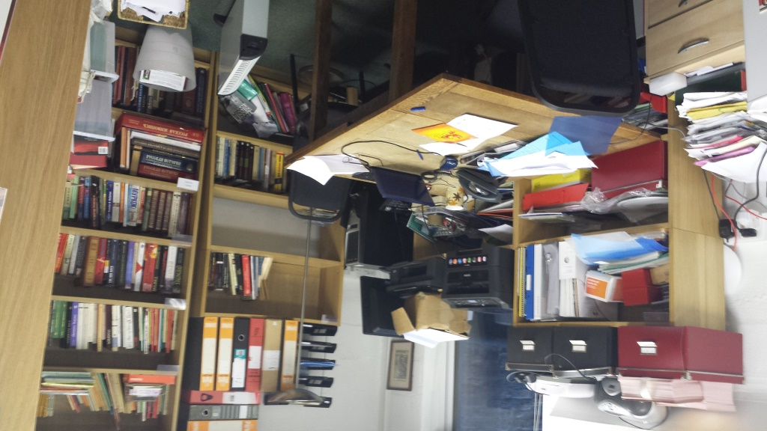
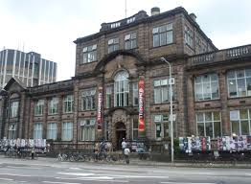
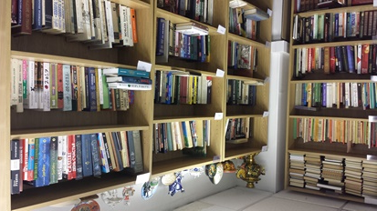

Slide 5
Activities
We try to interest in as many people as possible in Russia and its “neighbours”.
Promotion of events related to those countries
Our journal, available in print and online
Organise occasional events, social and informational
Work with many other organisations and individuals (advice, promotion of events, collaboration)
Try to get Russian / Russian culture into schools

Slide 6
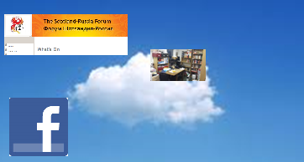
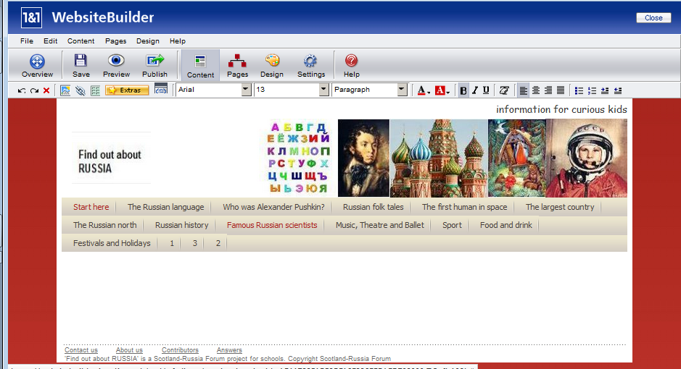
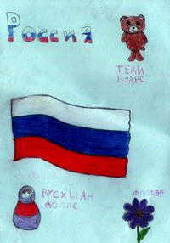
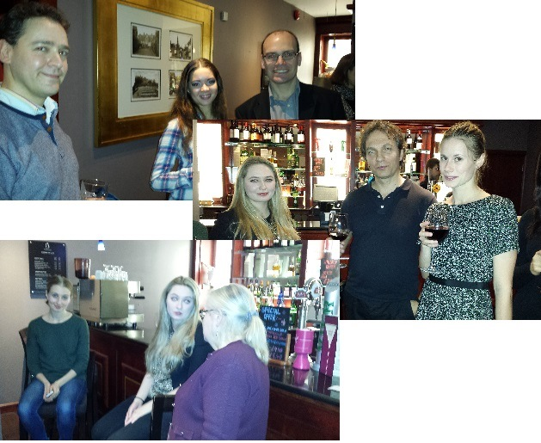
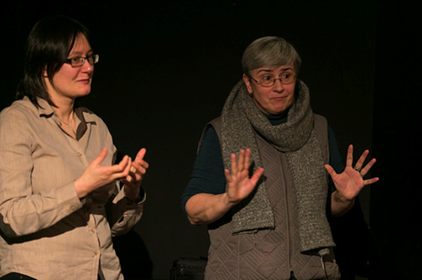
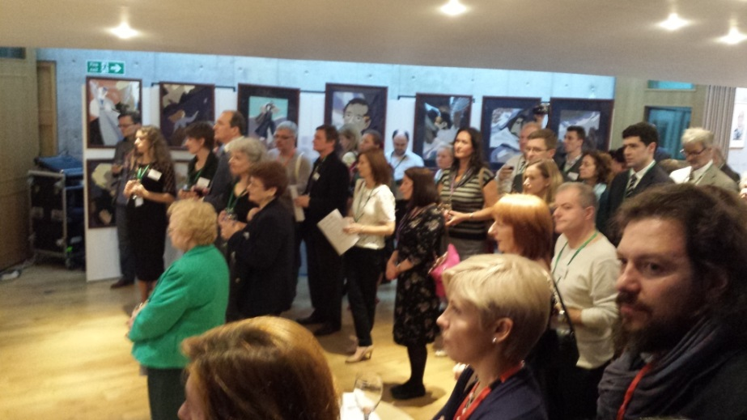
2014
Tasters in schools
(Feb) Reception for the Siberian Ballet
LGBT discussions and films
Lermontov exhibition and reception in Parliament
Events listings etc
NEW!! Website for children

Slide 7
Our reach
Membership 180 now (210 at end 2013-14)
Website av.7760 visits pcm
Circulation of e-bulletin 1100
Review 500cc circulated
Facebook “likes” 756
Twitter “followers” 378
 | Top 10 most popular pages in 2014 | Av Clicks per month
1. | Home | 3254
2. | Exhibitions | 563
3. | Language classes | 430
4. | What’s On | 378
5. | Links | 356
6. | Talks | 263
7. | Ukraine | 230
8. | About us | 219
9. | Keep school exams | 212
10. | Notices | 203
 | Facebook | Twitter
Academia Rossica | 10286 | 1798
Rossotrudnichestvo UK | 3935 | 14
Pushkin House | 2682 | 1696
AUGB | 2523 | 732
Russian Art & Culture | 1134 | 2198
SRF | 756 | 378
Dashkova Centre | 462 | 190
Westminster Russia Forum | 191 | 925
SCRSS | 171 | 0
RCS Haven | 114 | 23
GB-Russia Soc | 29 | 10

Slide 8
What do members think?
Should we keep our office? 62% said Yes
Do you use the Library and should we keep it?
Only 4% use it but 38% of non-users want to keep it
What do you think of the E-bulletin? 91% said it was very valuable
What do you think of the Review? 73% always read it
Other suggestions? Keep going!

Slide 9
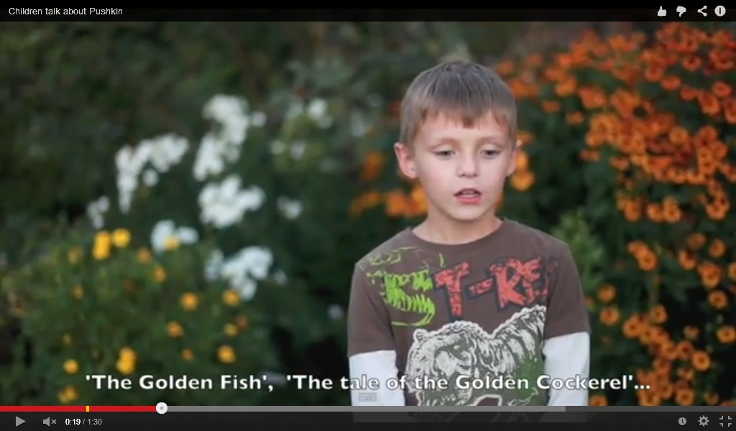

Slide 10
Thanks to:
Officers and committee
Members
Supporters, moral and financial
SRF Review team
Чай н Чат organisers
Language tutors
С новым годом!

