Slide 1
Why learn/teach Polish?
Look East?

Slide 2
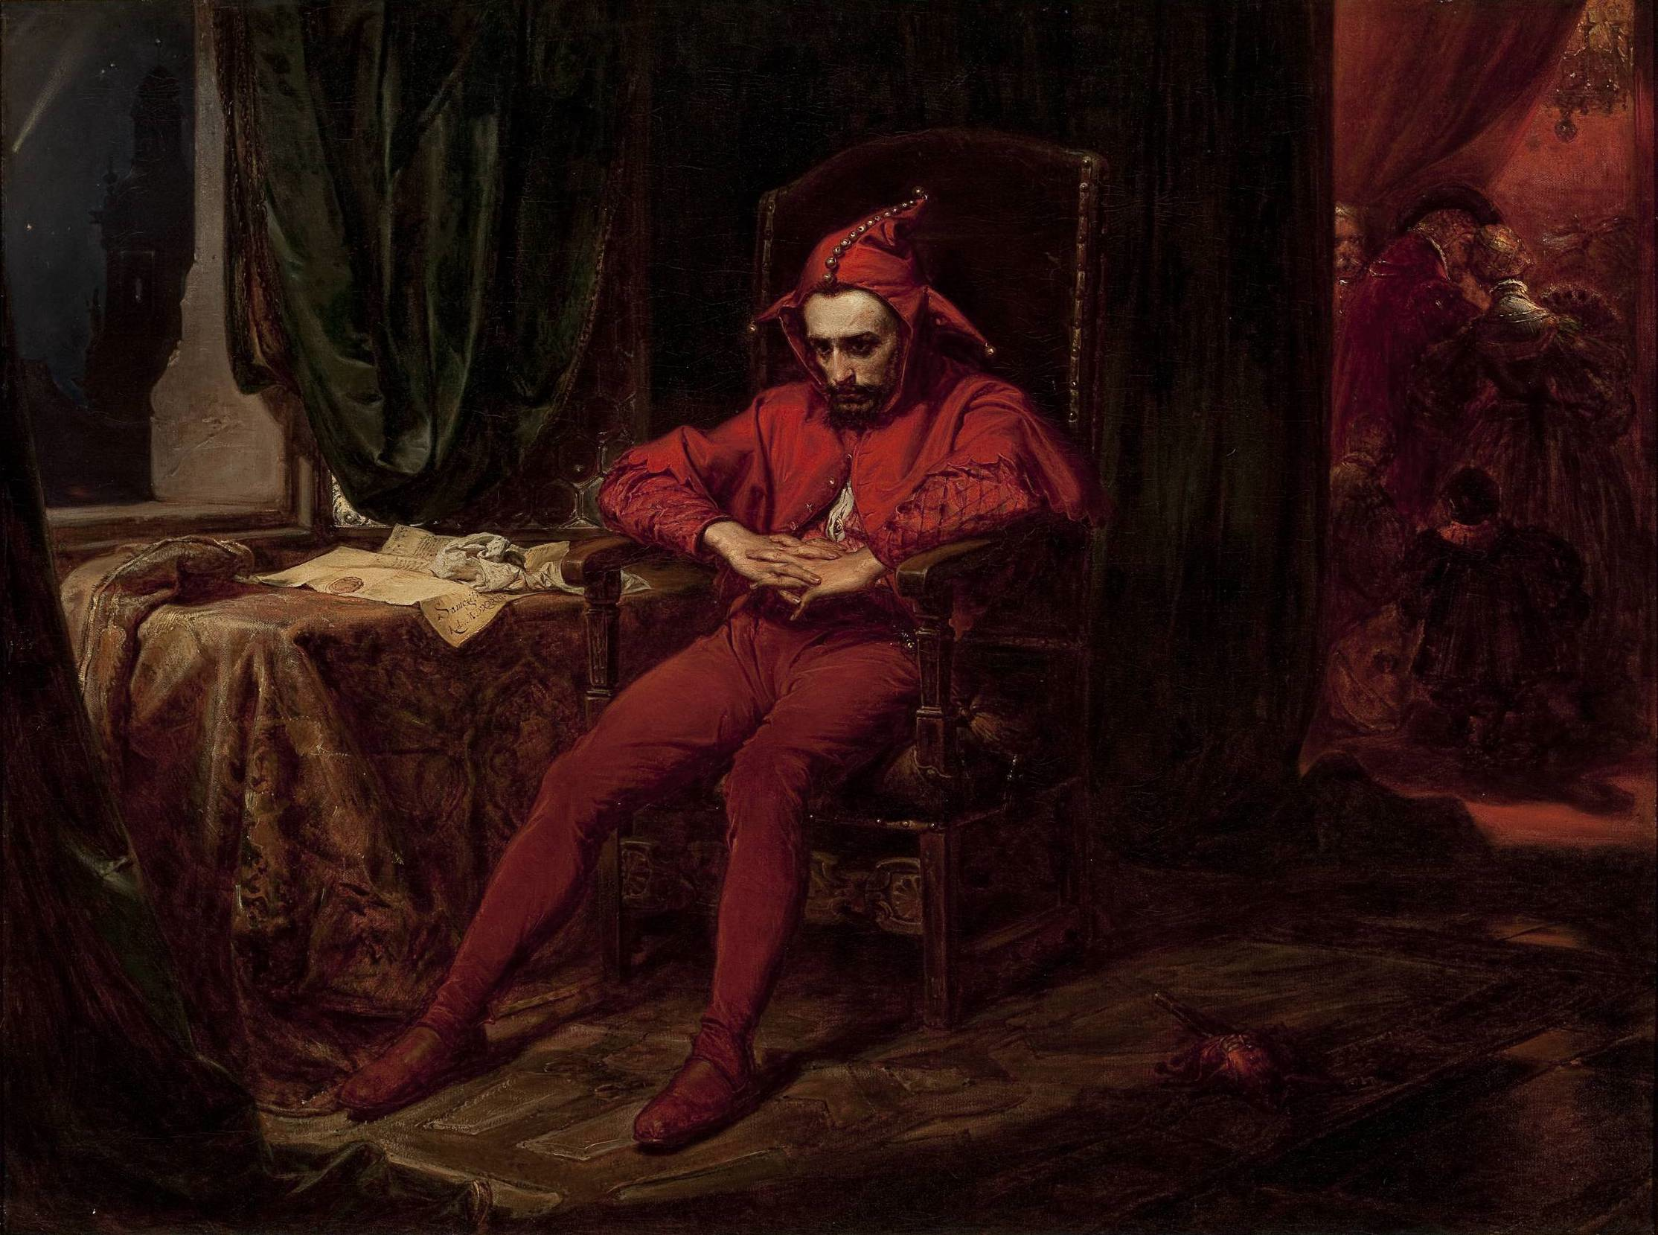
Notes:
Stańczyk (1480-1560) by Jan Matejko (1862). At news of loss of Smolensk (1514)

Slide 3
Poland: A bit of history
Poland-Lithuania was territorially the largest medieval state (1385-1572 dynastic union; 1573-1795 political union) …
Which didn’t exist (1795-1918)
And then existed differently (1918-39; post-1945)
https://www.youtube.com/watch?v=tOA2dtOLGSg
Animated history of Poland (with annotations)

Slide 4
Some UK-based historians
Norman Davies, God’s Playground (OUP, 1981), 2 volumes; Heart of Europe (1986)
Anita Prażmowska, Poland. A Modern History (Tauris, 2010/2013)
Robert Frost, The Oxford History of Poland-Lithuania. Volume I: The Making of the Polish-Lithuanian Union, 1385-1569 (OUP, 2015)
Richard Butterwick, The Polish Revolution and the Catholic Church, 1788-1792: A political history (OUP, 2012)
Poland’s Last King and English Culture: Stanisław August Poniatowski, 1732-1798 (1998)

Slide 5
Polish Cinema
Andrzej Wajda (Katyń)
Roman Polański
Krzysztof Kieślowski (Three Colours)
Agnieszka Holland (The Wire)
Paweł Pawlikowski (Ida)
English-language analyses of the above by academics like Paul Coates, Marek Hendrykowski, Ewa Mazierska

Slide 6
Polish Language Teaching
About a dozen Polish ML teachers registered to teach Polish at secondary level
Polish Educational Committee (PEC)
Polish Language Learning in Scotland (Anna Martowicz with Andrew Roach)
c. 15000 pupils in primary to secondary education within Scotland (95000 Poles)

Slide 7
Polish
Źdźbło (a blade of grass)
Żubr (bison)
Żubrówka (bison-grass vodka)
Szarlotka (apple pie)

Slide 8
Koniec
Dziękuję za uwagę
Thank you for your attention

